Slide 1
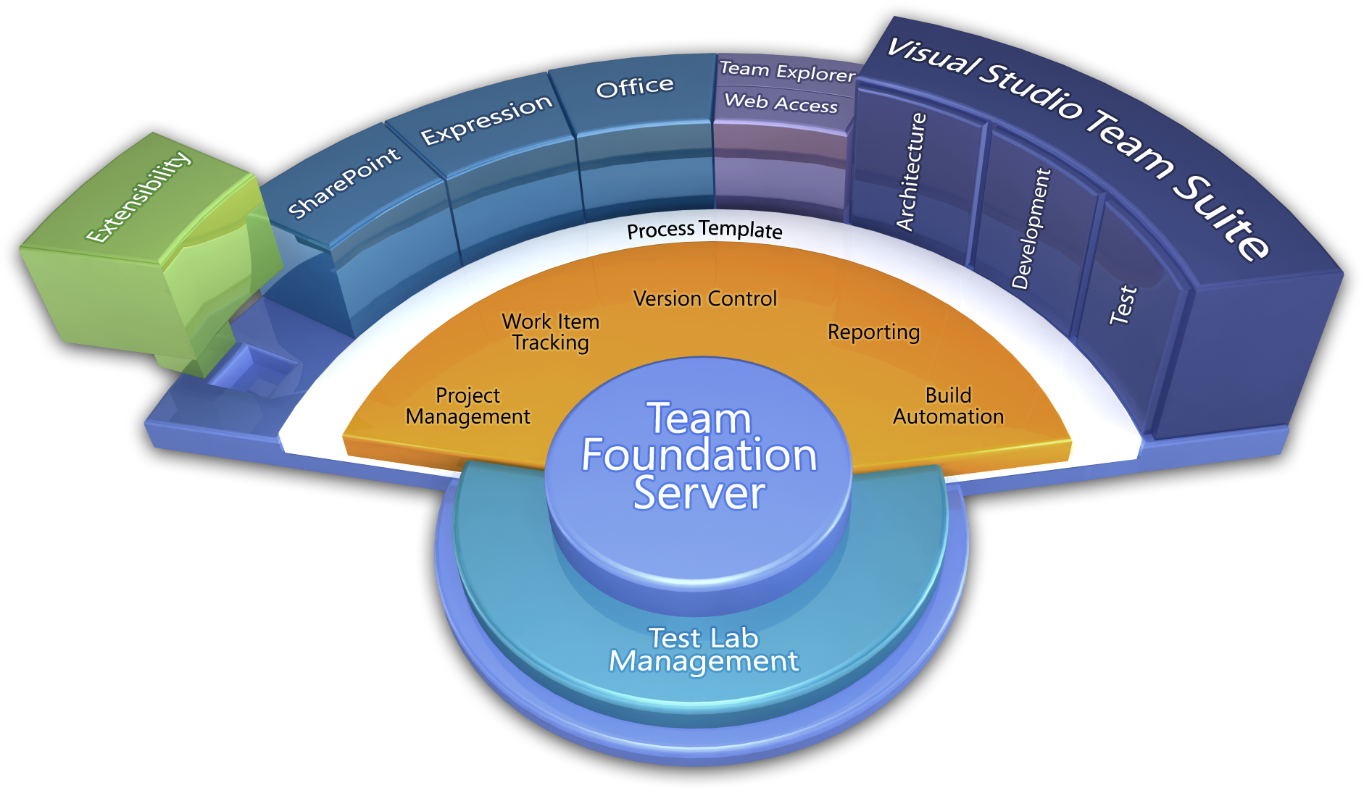
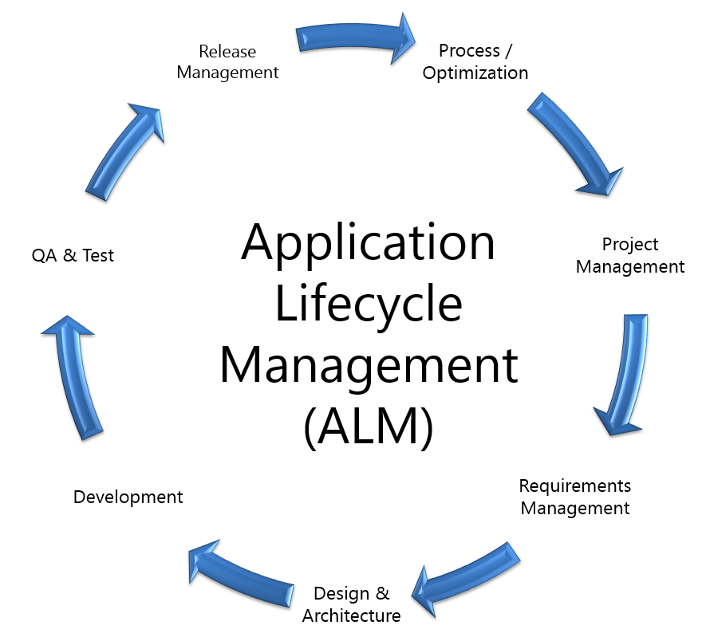
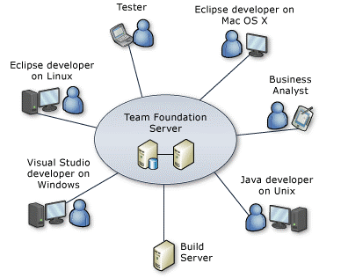
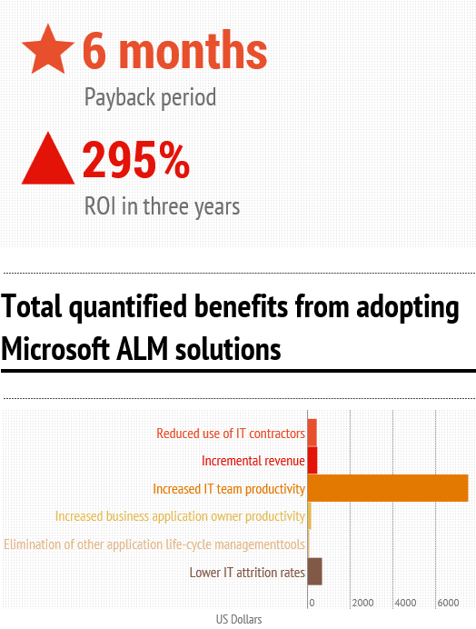

Enterprise Team Foundation Server
Software Factory NTI
Michael O’Brien SEMS / Software Systems | Toby Hable SEMS / Software Systems
Stakeholders
HIS
DOC
IPD
CRL
IT
TSSD
SOSD
MVSS
Unitek
Enterprise Team Foundation Server is an installation of Microsoft Team Foundation Server which provides source code management, reporting, requirements management, project management, automated builds, lab management, testing and release management capabilities for all of 3M.
Process / Optimization
Project Management
Requirements Management
Design & Architecture
Release Management
Development
QA & Test
Application Lifecycle Management (ALM)
Application Lifecycle Management using Visual Studio Team Foundation Server provides proven practices to manage application lifecycle. Manage source code across teams; develop, build, and test applications; plan projects, track work, and report progress.
Project Accessibility
Provide project accessibility to team members and stakeholders from development environments or a web interface. Manage your backlog, measure progress, automate builds, trace testing back to requirements, automate deployments – all with ETFS.
Testimonials
“We reduced the average project turnaround time by 35% … due to transparent task assignment, 360-degree awareness of customer requirements, and a shared understanding of what each coding project must achieve.”
Kha Thach, Offshore Development Centre Manager, DiCentra
“We need state of the art development processes to attract the best employees and stay ahead of our competitors through continuous innovation. Using Team Foundation Server to support agile development methods enables us to provide more business value to the bank.”
Arno Tersteeg, Global Head Professional Services and IT Risk Management, Rabobank
“From a productivity perspective, we would conservatively estimate that our teams, on average, save at 2-4 hours a week by having TFS in place.”
Alan Smyth & Curt Morgan, IPD, 3M
Learn more at http://tfs.mmm.com
Infography created by InCycle Software
Source information from Forrester: The Total, Economic Impact of Microsoft Application Life Cycle Mangement

